Slide 1


Team 10: Implementing a GRU based network to detect stock prices on FPGA
Bi-Weekly Update 5 Sean Kwatra, Xavier Fisher, Kevin Sipple Sponsor: Sambandh Dhal
TA: Eric Robles
ECEN 404
Bi-weekly Presentation #5
Notes:
Xavier

Slide 2
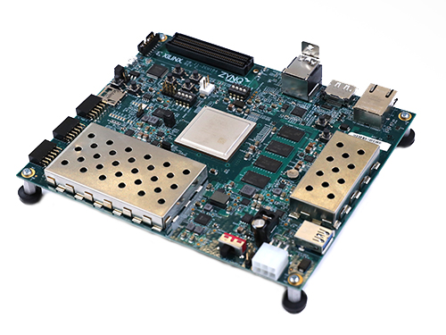
Project Summary
Issues Our Solution Seeks to Fix
Retail Traders are inexperienced
Analysis tools are expensive
Paywalls to professional analytics
Our Solution: A GRU Based Stock Prediction System (GBSPS)
Provide a low cost machine learning system capable of running on limited processing power devices.
Provide retail traders with an easy-to-use tool for analyzing stock data and create a accurate prediction of the direction of stock price movement.
Facts
Current estimates place 32% of total U.S. equity volume to be represented by retail traders [ConOps].
The number of active retail traders across six largest non-commission platforms was 100 million [ConOps ( statistic from Jan. 2021)].
Notes:
Kevin

Slide 3
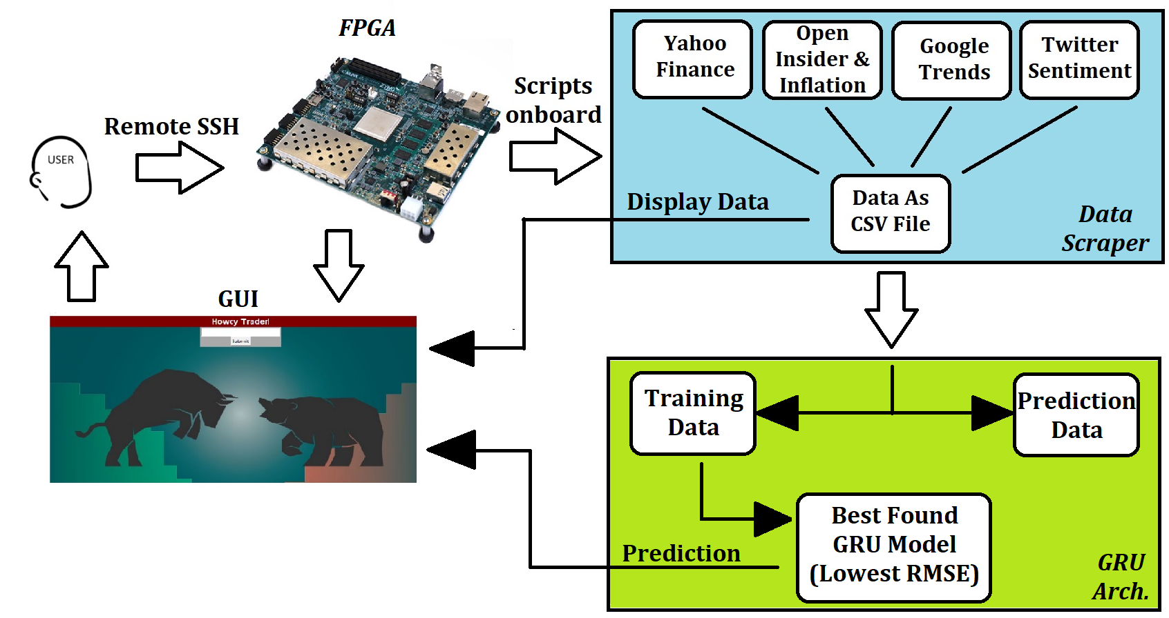
Integrated System Diagram
Notes:
Kevin

Slide 4
Key Timeline Milestones
These are our large scope tasks needed to achieve full integration.
Meet with Sponsor for initial 404 Update (ASAP) | Load first GRU onto the FPGA for test run (8/29) | Create a user input/error system compatible with all subsystems (9/26) | Integrate the Data Scraper with the GRU (10/10) | Fully integrate the final scripts onto the FPGA “Full integration” (10/31)
Group | Sean | Kevin & Xavier | Group | Sean
Notes:
sean

Slide 5
Data Scraping and Processing Subsystem
Xavier Fisher
Accomplishments since Bi-week 4 16 hrs of effort | Ongoing progress/problems and plans until the next presentation
Hard-coded start dates Tested edge cases and erroneous inputs Implemented additional error handling capabilities (try/except) Changed logic of data assignment | Further integrate with/accommodate GUI for seamless operation Fix errors/bugs as they are discovered
Notes:
Xavier

Slide 6
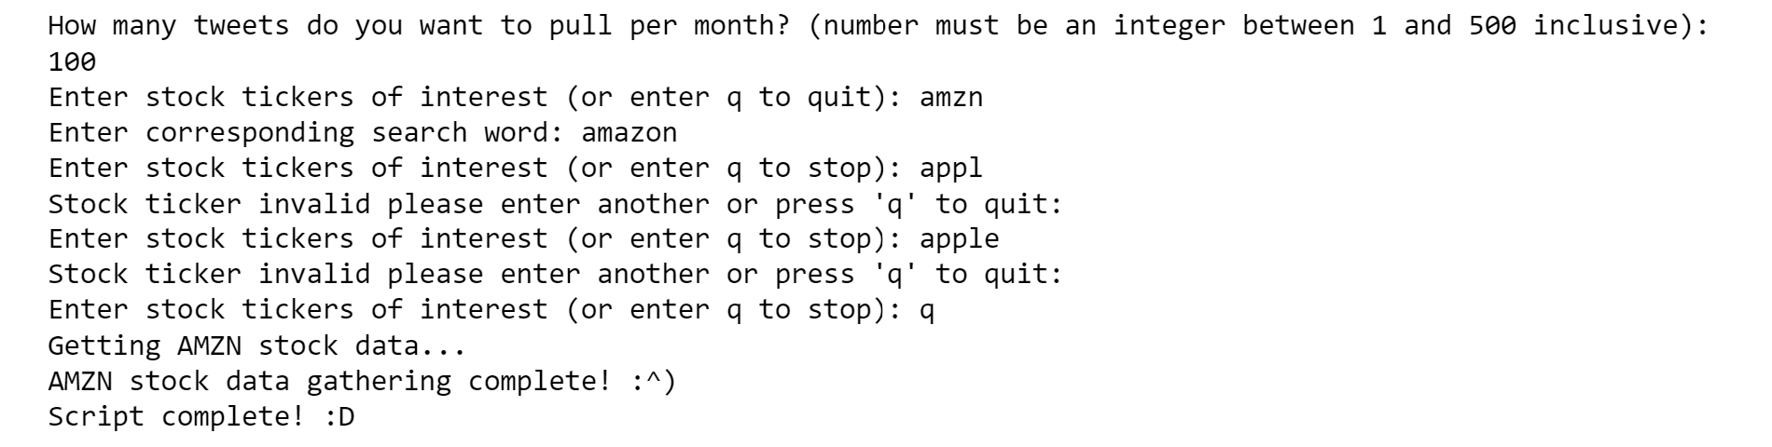
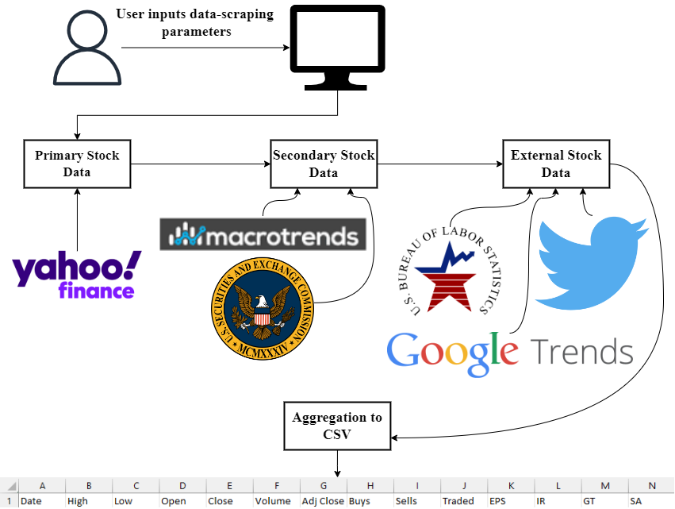
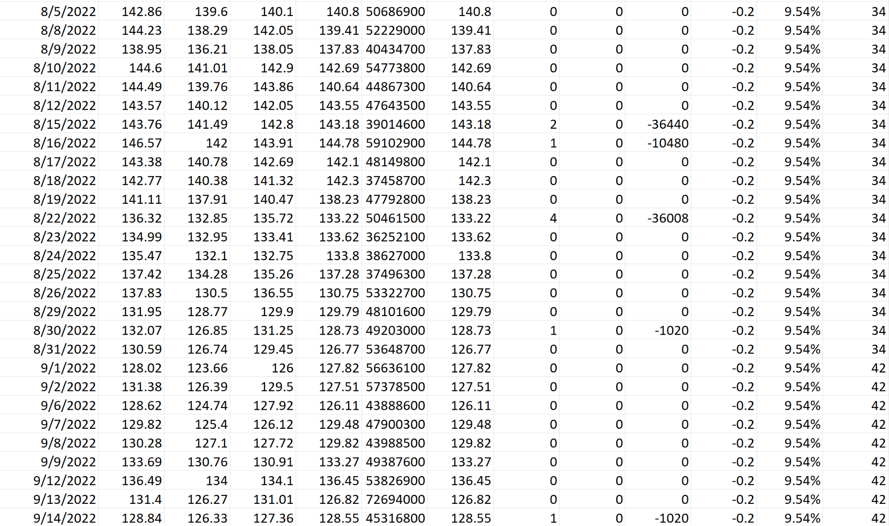
Data Scraping and Processing Subsystem
Xavier Fisher
Notes:
Xavier

Slide 7
FPGA Subsystem
Sean Kwatra
Accomplishments since Bi-week 4 30 hrs of effort | Ongoing progress/problems and plans until the next presentation
Completed full integration Ran full battery of stocks on FPGA | Continue to improve GRU’s accuracy Look for and fix any minor errors Provide feedback to GUI
Notes:
sean

Slide 8
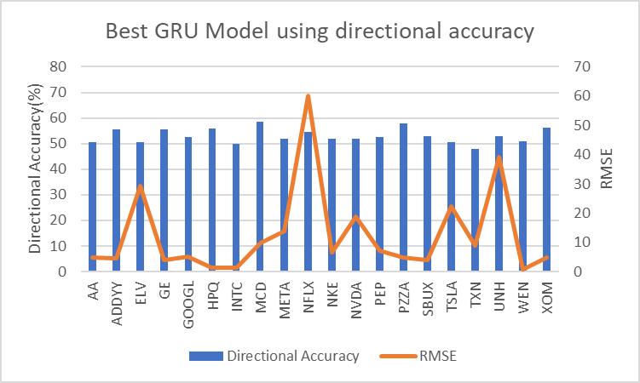
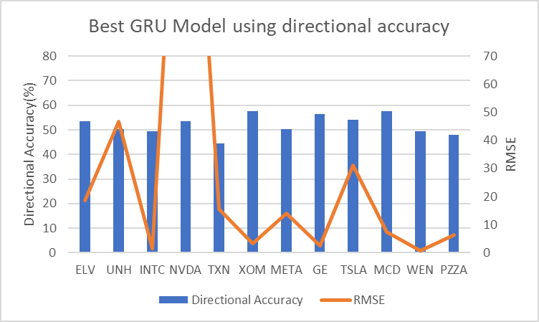
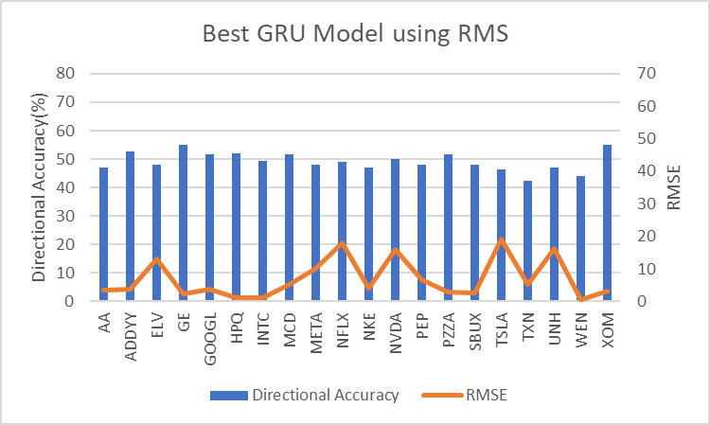
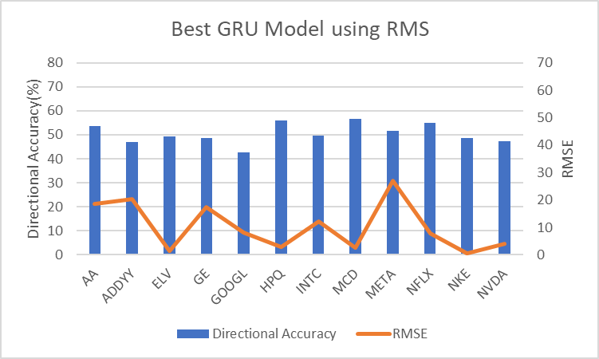
FPGA Subsystem
Sean Kwatra
OLD:
NEW:
Notes:
sean

Slide 9
GRU Architect Subsystem
Kevin H. Sipple
Accomplishments since Bi-week 4 ~45 hrs of effort | Ongoing progress/problems and plans until the final presentation
Created new scaling method Made more error handles! Validated GRU operation and new error handles Created New Prediction Data Script Improved GUI design… A lot | Eliminate attribute combos Continue to make error catches Add missing attribute handle into data prep script
Validated: Only valid stocks can be entered
Validated: Data is kept up to date (weekends also)
Validated: Attributes Of Best Model Kept
By next week: GUI should be completed

Slide 10
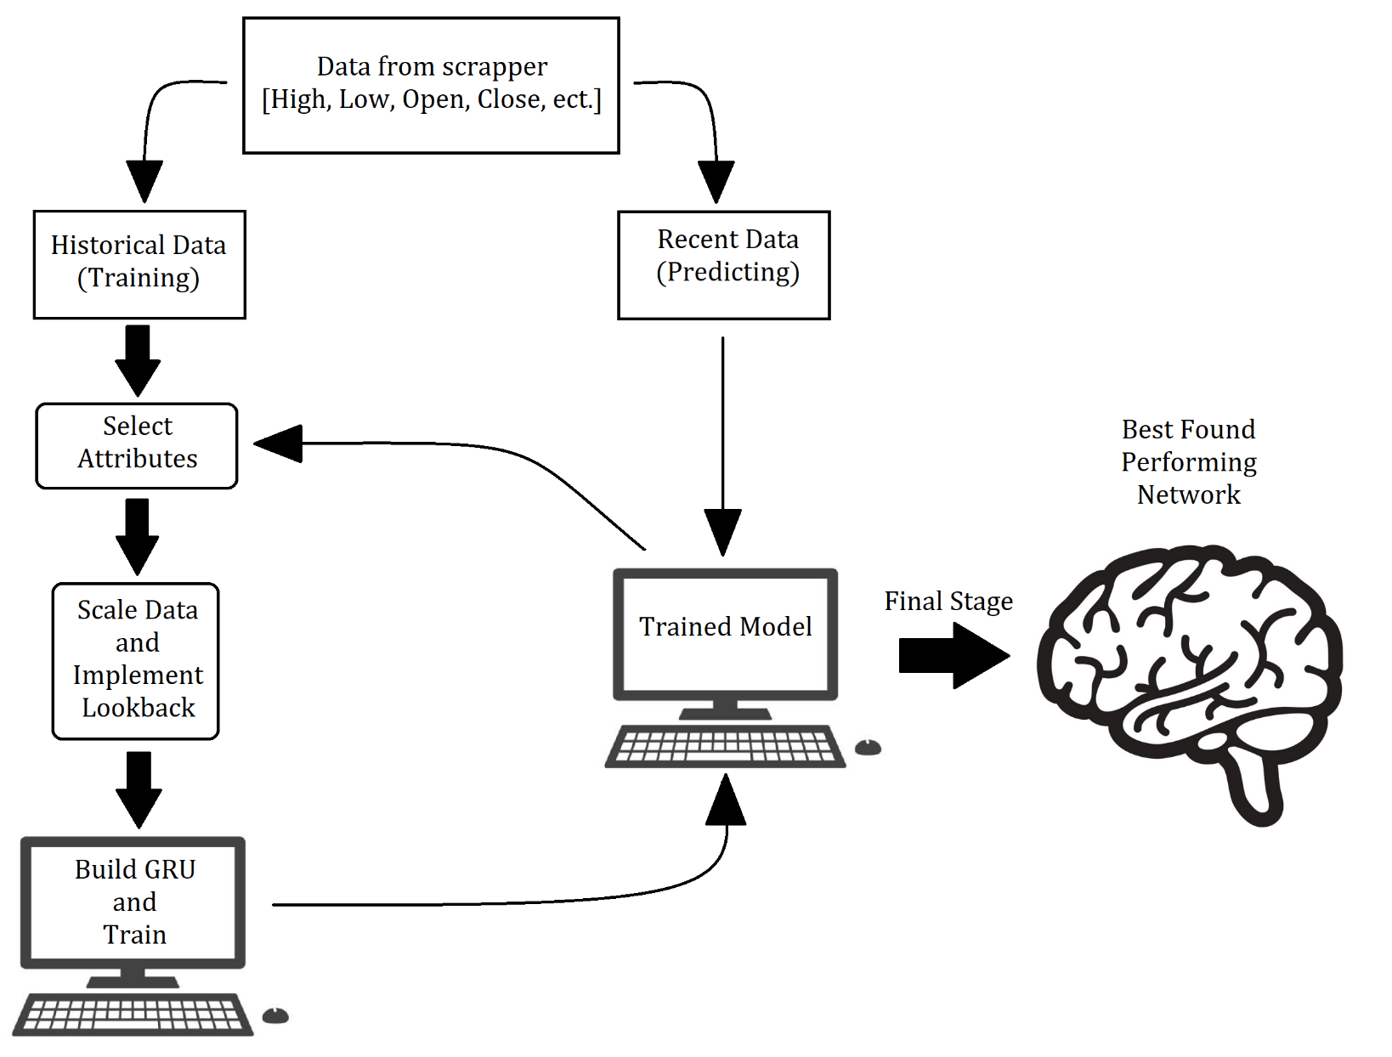
GRU Architect Subsystem
Kevin H. Sipple

Slide 11
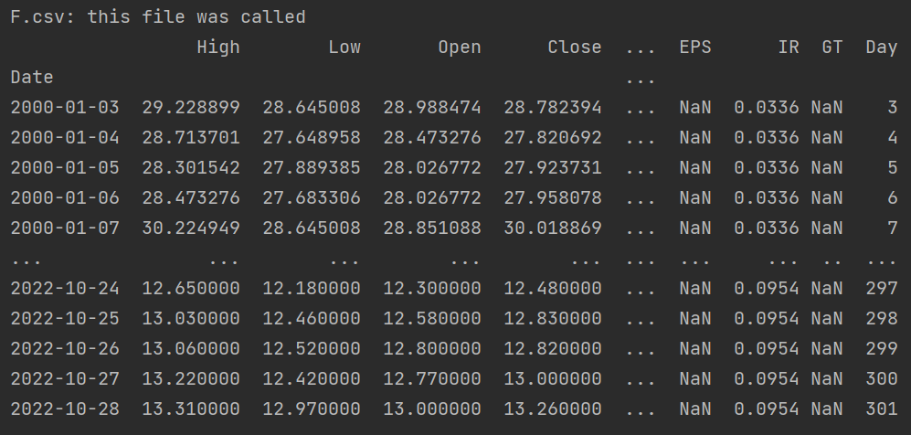
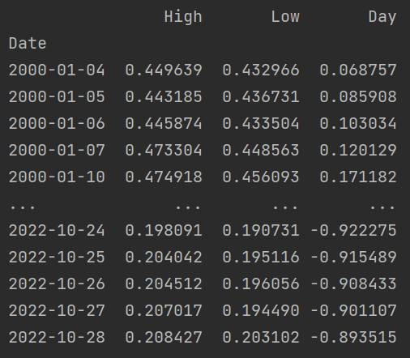
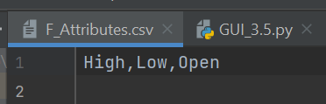
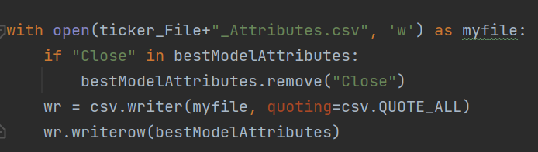
GRU Architect Validation
Kevin H. Sipple
Select Attributes From Dictionary
Saved The Best Attributes

Slide 12
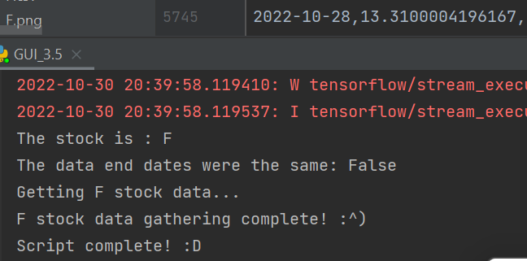
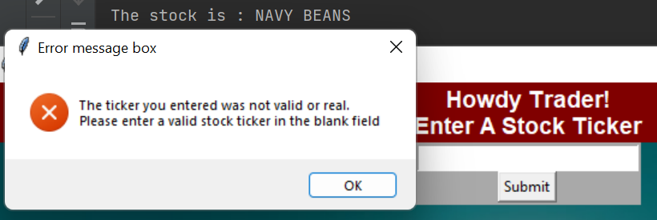
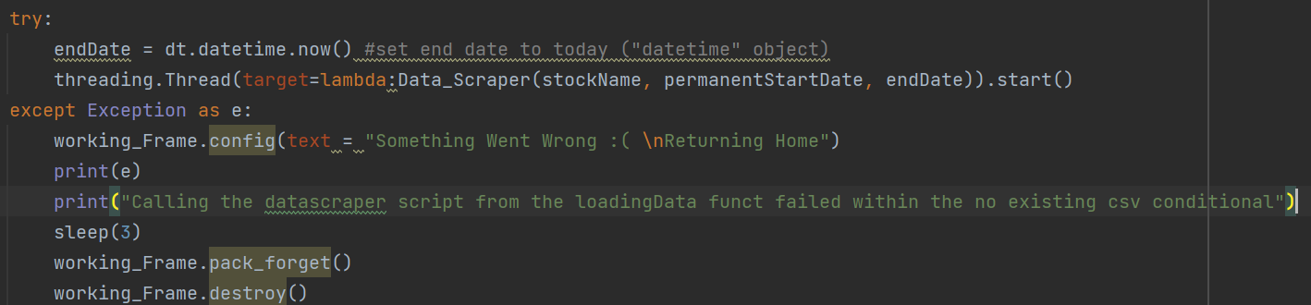
GRU Architect Validation Cont.
Kevin H. Sipple
Error Catch Tickers
Compare and Update Dates
If Scarper Failures Will Return Home

Slide 13
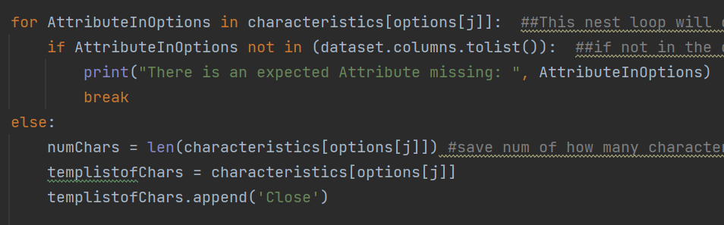
GRU Architect Validation Cont.
Kevin H. Sipple
Error Catch Missing Attributes

Slide 14
404 - Execution Plan
Not Started
Complete
In Progress
Delayed
Cancelled
Task has been undecided
TASKS | 8/29 | 9/5 | 9/12 | 9/19 | 9/26 | 10/3 | 10/10 | 10/17 | 10/24 | 10/31 | 11/7 | 11/14 | 11/21 | 11/28
Create GitHub for project - S
Meet with sponsor - Gr
Make GRU save best model for use - K
Test performance, accuracy, and FPGA compatibility - S & K
Market sentiment issue sorted out - X
Debug Google Trends - X
Bi-weekly Update #1 - Gr
Create User input system - X & K
Integrate GRU Script and Data Scraping Script - X & K
Bi-weekly Update #2 - Gr
Start Designing case -S
Integrate the full software of GRU and Data Scraper -Gr
Print case and mount onto FPGA - S
Bi-weekly Update #3 - Gr
Bi-weekly Update #4 - Gr
Bi-weekly Update #5 - Gr
Fully Finish GUI
Final Design Presentation - Gr
Thanksgiving Break
FINAL REPORT DUE 3rd

Slide 15
Key Validations
Test GRU script to ensure best found model is saved and used for predictions | Test error handling capability and data formatting to ensure script can handle bad or missing data points | Test user input system error handling and run multiple tickers to test functionality | Run a GRU script on the FPGA to ensure models can be trained on board | Run the GRU on a wide selection of stocks and sectors to test usability/ accuracy
Kevin | Kevin | Group | Sean | Group

Slide 16
Thank you for listening.
Questions?

